Slide 1
Measuring Turbidity of Water to Determine Water Quality using Arduino and Turbidity Sensor

Slide 2
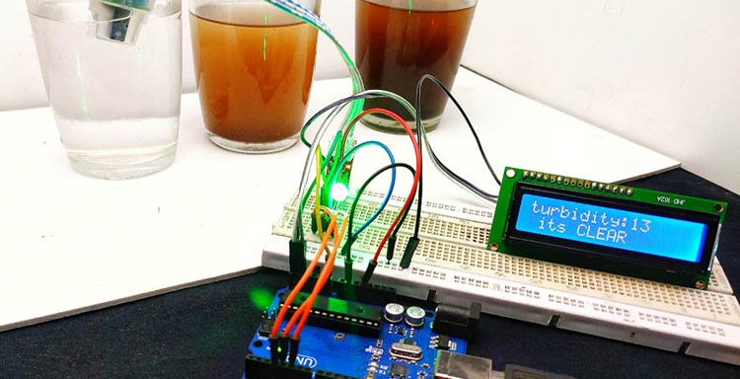
Check the purity of water
Measuring Turbidity of Water using Arduino and Turbidity Sensor

Slide 3
What is Turbidity in Liquid?
Turbidity is the degree or level of cloudiness or haziness of a liquid. This happens due to the presence of large numbers of invisible particles (with the naked eye) similar to white smoke in the air. When light passes through liquids, light waves get scattered Due to the presence of these tiny particles. The turbidity of a liquid is directly proportional to the free suspended particles that is if the number of particles increases turbidity will also increase

Slide 4
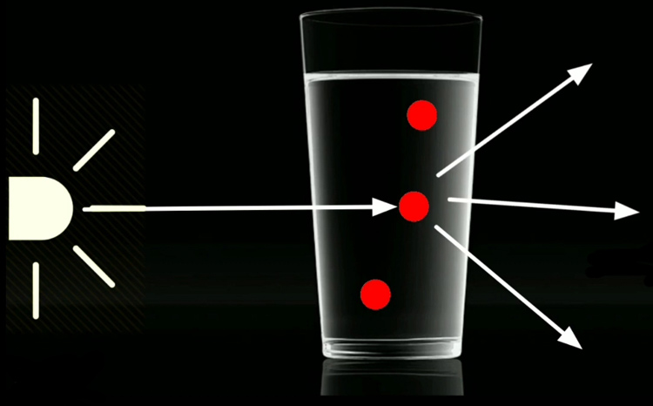
One of principle way to measure turbidity by the light

Slide 5
How to Measure Turbidity using Arduino?
As I mentioned earlier, turbidity happens due to the scattering of light waves, in order to measure the turbidity, we should measure the scattering of light. Turbidity is usually measured in nephelometric turbidity units (NTU) or Jackson turbidity units (JTLJ), depending on the method used for measurement. The two units are roughly equal

Slide 6
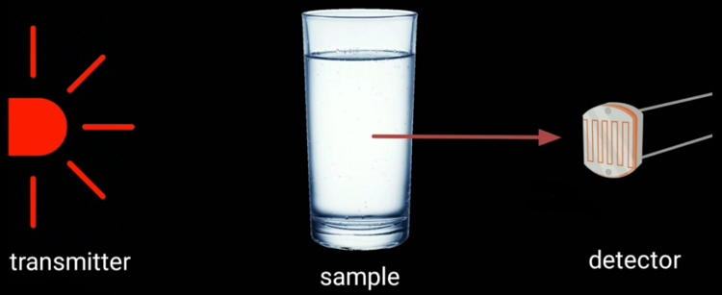
turbidity sensor works, it has two parts, transmitter and Receiver. The transmitter consists of a light source typically an led and a driver circuit. In the receiver end, there is a light detector like a photodiode or an LDR. We place the solution in between the transmitter and receiver.

Slide 7
Components Needed for Making Turbidity Meter
Turbidity module
Arduino
16*2 I2C LCD
Common cathode RGB LED
Breadboard
Jumper wires

Slide 8
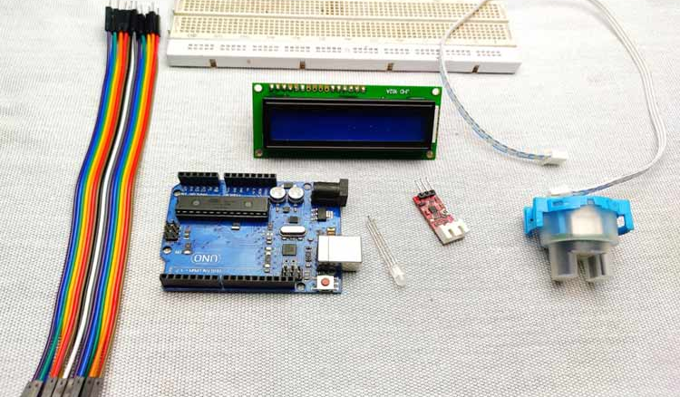

Slide 9
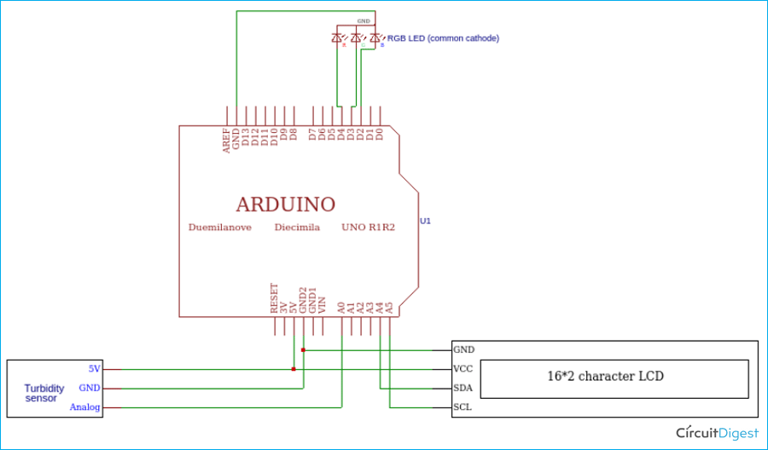
Interfacing Turbidity Sensor with Arduino – Circuit Diagram

Slide 10
Way to connect circuit of Turbidity with arduino
The output of the turbidity sensor is analog so that connected to Arduino's A0 pin, I2C LCD connected to I2C pins of Arduino that is SCL to A5 and SDA to A4. Then the RGB LED connected to digital pin D2, D3, and D4. After the connections are done.

Slide 11
Connect the VCC of the sensor to Arduino 5v, then connect ground to ground. The output pin of the sensor to analog 0 of Arduino. Next, connect VCC and ground of LCD module to 5v and ground of Arduino. Then SDA to A4 and SCL to A5, these two pins are the I2C pins of Arduino. finally connects the ground of RGB LED to the ground of Arduino and connect green to D3, blue to D4, and red to D5.

Slide 12
project goals
This project it made to measure the Turbidity of water and check if the project good for humanity usage by the light that go out from sensor and measure the intensity of light that receives from other side of sensor and Arduino change it to measuring values and display to the screen.

